Slide 1
Regression
https://goo.gl/MtFYOw

Slide 2
Plan
Regression theory recap: Linear, Ridge, Lasso, SVR
(hypothesis form, optimization problem, solution, practical advantages and disadvantages)
Demo problems:
Linear vs Lasso vs Ridge vs Linear SVR
Ridge vs Lasso feature selection (+ application to the compressive sensing reconstruction)
Kernel Ridge vs Kernel SVR
NuSVR (fraction of training errors vs fraction of support vectors)
Practice (challenge)
Bike rental forecast from kaggle

Slide 3
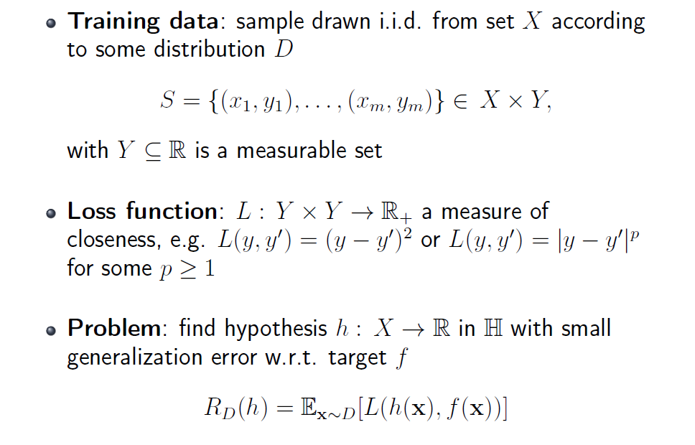
Regression problem statement

Slide 4
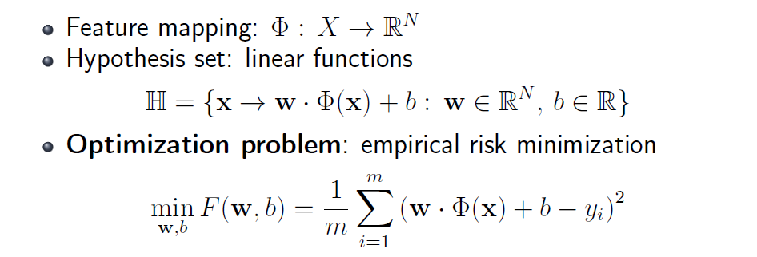
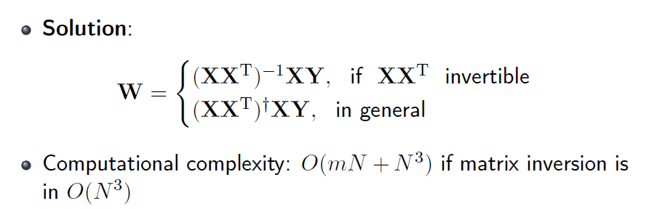
Linear regression

Slide 5
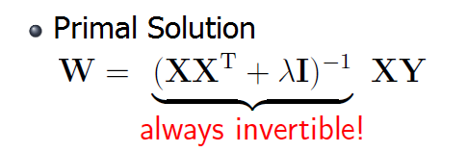
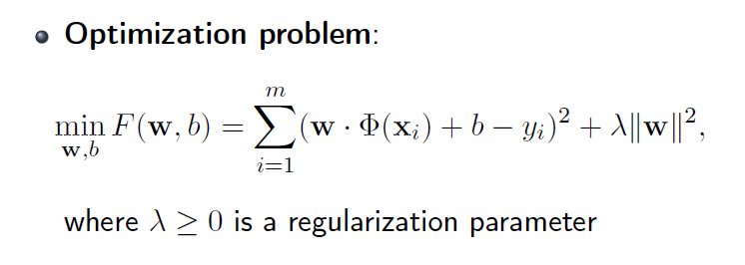
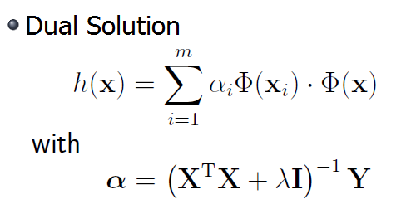
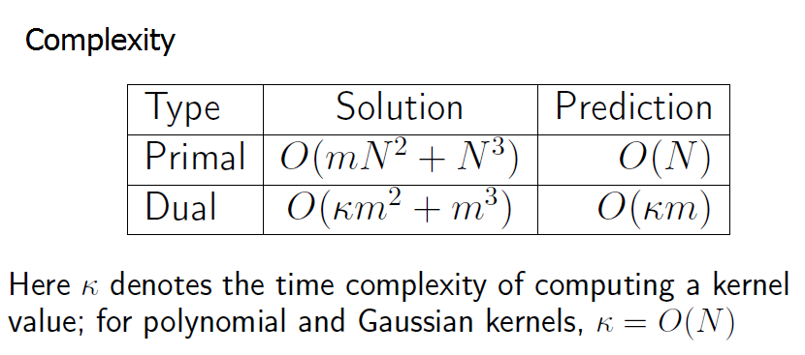
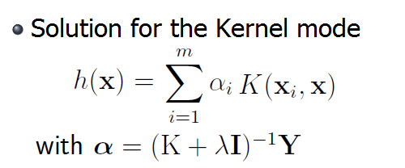
Ridge regression

Slide 6
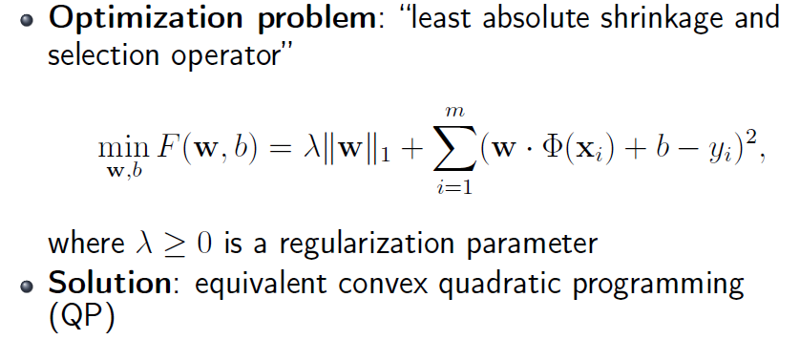
LASSO

Slide 7
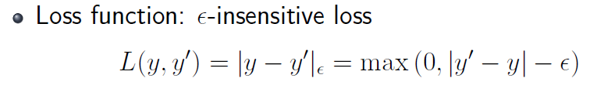
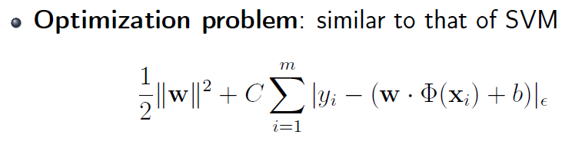
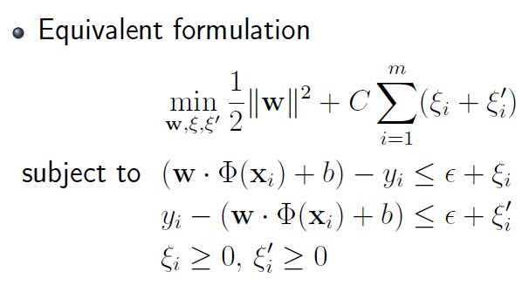
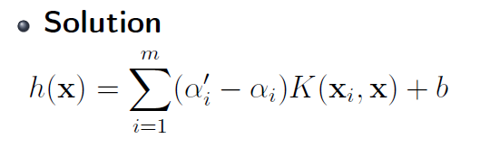
Support Vector Regression

Slide 8
Comparison of methods
Regression method | Closed-form solution | Use of Kernels | Sparseness | External parameters
Linear | + | - | - | -
Ridge | + | + | - | λ
LASSO | - | - | sparse features | λ
Support Vector | - | + | sparse points | C, ε

Slide 9
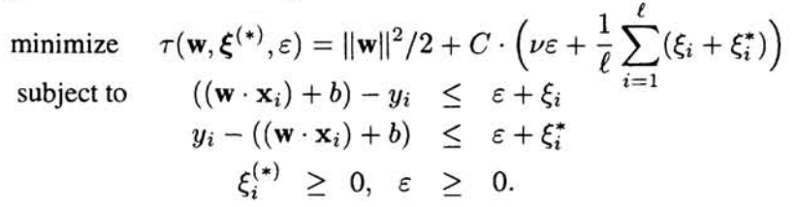
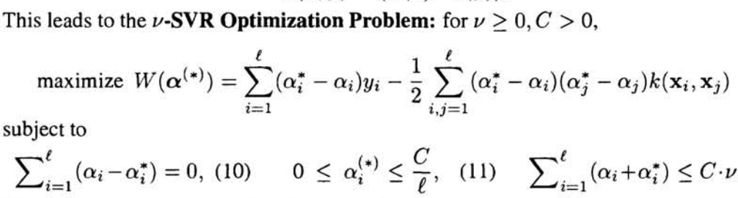
Extra: NuSVR

Slide 10
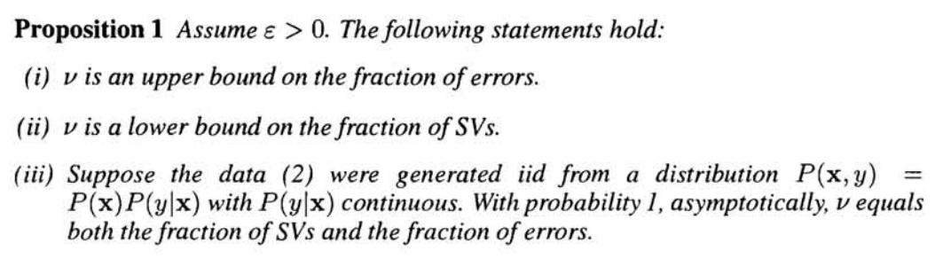
Extra: NuSVR

Slide 11
Demo problems
Notebook: https://drive.google.com/open?id=0B8-5d8BzFWHgV0JYX3JIclVWUmc

Slide 12
Practice
Notebook: https://drive.google.com/open?id=0B8-5d8BzFWHgODhWcDhGQjB0SkU
Train data: https://drive.google.com/open?id=0B8-5d8BzFWHgRGNWN1I4TElZRUk
Test data: https://drive.google.com/open?id=0B8-5d8BzFWHgTVhCSVJMZFZSeE0
Report: https://goo.gl/forms/86E2ARUIpOJN4lWy1

